Slide 1
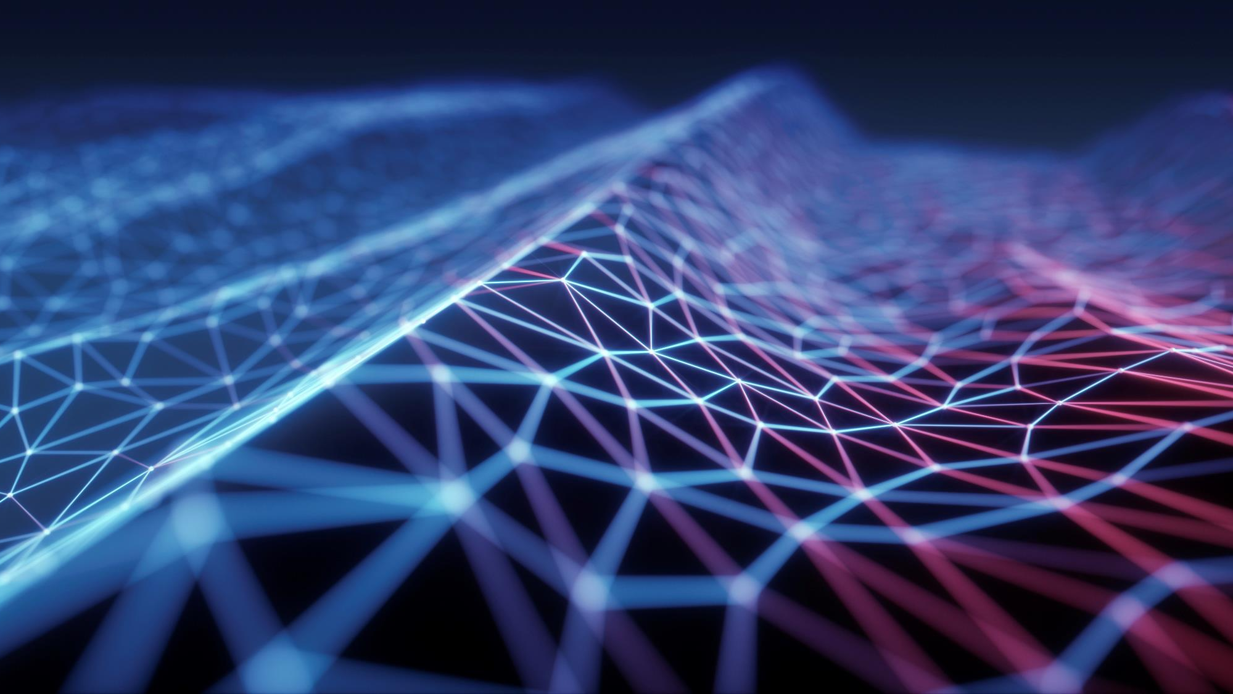
Security in cyberspace
Omar, Annie, Mitchell, And Nawal

Slide 2
learning objectives
Computer Security
Cybersecurity as Related to Cybercrime
Security vs Privacy
Three Categories of Cybersecurity
Cloud Computing and Security

Slide 3
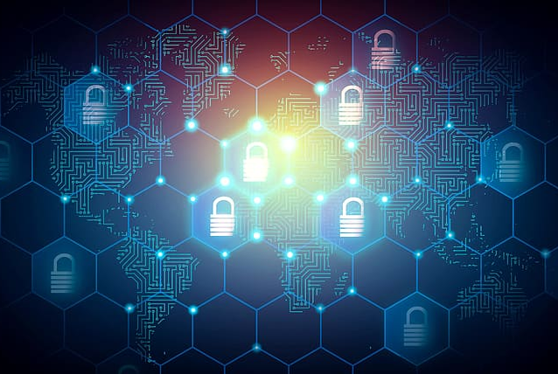
History Of security and cybercrimes
Security issues and cybercrime issues began in 1970s and 1980s
In 1990s use of internet expanded. Computers and personal laptops were becoming popular
Digital piracy and cyber stalking were surfacing
In 2007 and 2008 Facebook got hacked
In 2016 Yahoo reported major Data Breach
In 2021 Colonial pipeline largest cyberattack in the history of Unites States

Slide 4
History notes that Nawal made
The history of cyber security starts back in the 1970s and 1980s. There were numerous crimes that involved the use of computers and personal laptops to launch the first computer viruses to break into financial and government institutions.
Then ini the 1990s when the internet blew up and became hot into the mainstream society, security became a huge issue and a concern. We were facing more and m ore cybercrimes which involved digital piracy, cyber stalking, cyberpornography and internet pedophilia. And then social medical really exploded anccyber bullying and sexting phishing became the newly cyberattacks and a huge security problem.
Then hacking started in the first decade of this century to be exact intime it started in 2007 and 2008. Facebook accounts users were hacked and people had their privacy ,data and pictures and personal hacked into. So then Security became so important because cybercrimes were increasing due to security issues.
As cybercrimes were rising more and more companies were being hacked into and stealing information that would cause millions and millions dollars in damage. For example, in 2016 yahoo disclosed that hackers stole data from 1 billion yahoo users and forged cookies that would allow the intruders to access user aacounts. This is one of the first data breach to be reported.

Slide 5
History continued
Next is when the Colonial pipeline catastrophe happened in 2021. An American oil system in Texas suffered the larges cyber attack and was the largest one ever in the United States. It was a ransomware cyber attack tht impacted computerized equipment managing the pipeline. The criminals were identified by the FBI as the “ dak side” group as the responsible parties. The company paid the ransom in the amount of 75 bit coins o millions of dollars. After that the group provided colonial pipeline an IT tool to restore their system and services which was upper complicated. It is also believed the group had stolen 100 gigabytes of data from the company before the attack. Later the Dept of Justice recovered 63.7 bitcoins or 2.3 million.

Slide 6
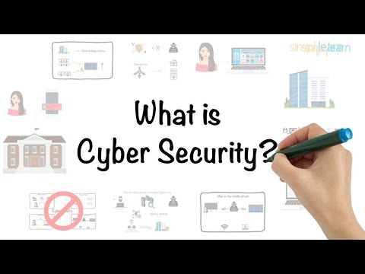
INTRODUCTION
Picture an employee scenario
A hacker secretly accesses to company's confidential files.
Real-life examples

Slide 7
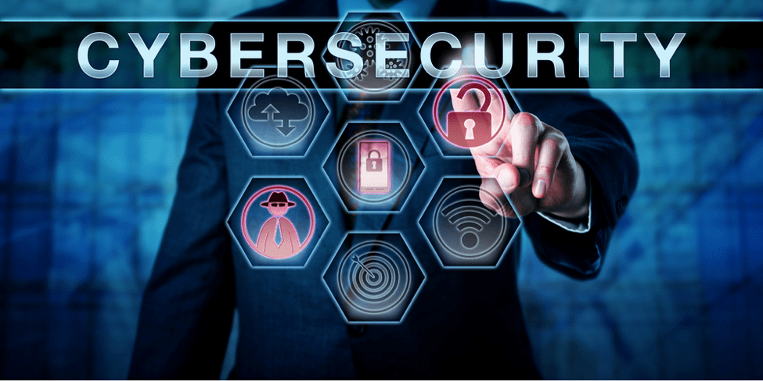
What is Cybersecurity?
Consists of technologies, processes, and controls, designed to protect systems, networks, programs, devices, and data from cyber-attacks.
This Photo by Unknown author is licensed under CC BY-NC-ND.

Slide 8
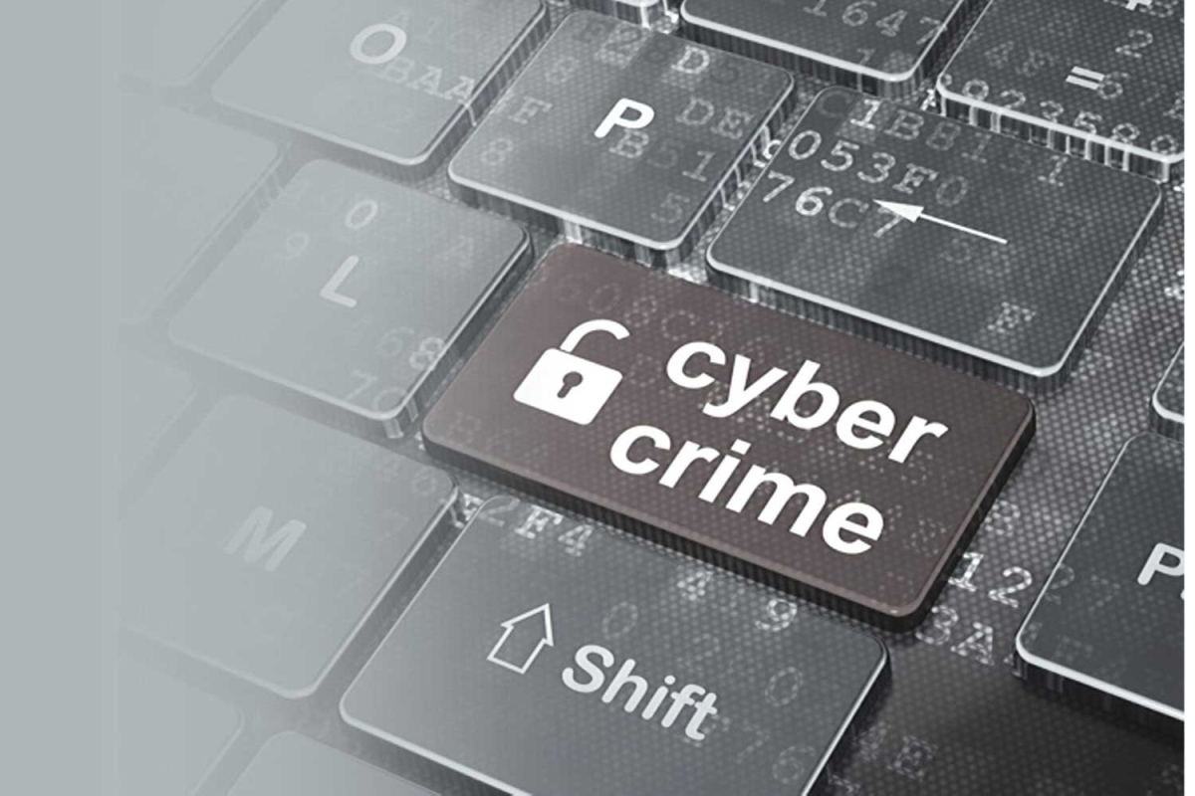
Cybersecurity vs Cybercrime
Both issues fall under the cyberethics umbrella.
Cybertech violations are virtually always criminal in nature.
Cybercrimes not always have direct implications for cybersecurity.
This Photo by Unknown author is licensed under CC BY-NC-ND.

Slide 9
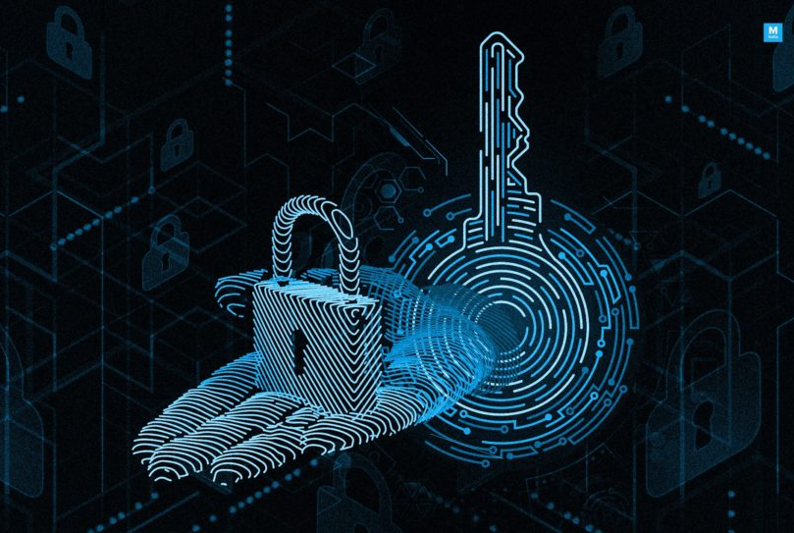
security vs Privacy
Both concepts can overlap.
With the same respect to confidentiality and data integrity.
Two sides of a single coin, each side complements and completes the other.
This Photo by Unknown author is licensed under CC BY-SA.

Slide 10
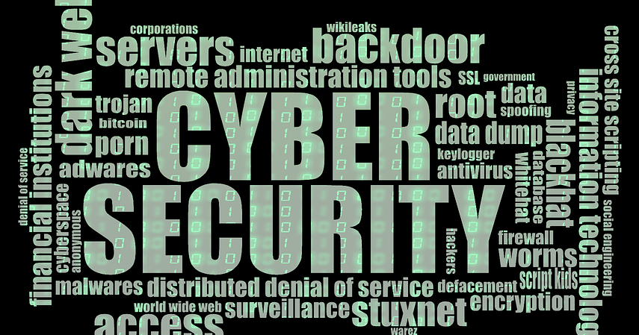
Three aspects of cybersecurity
Data Security
System Security
Network Security
This Photo by Unknown author is licensed under CC BY-SA.

Slide 11
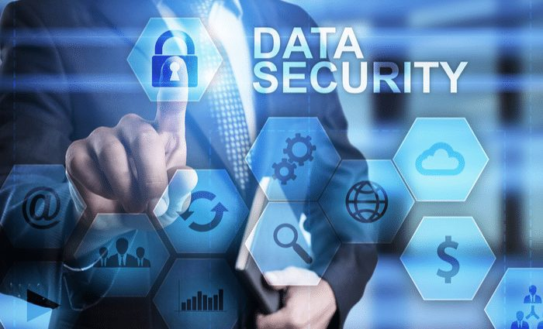
Data security
What is Data Security

Slide 12
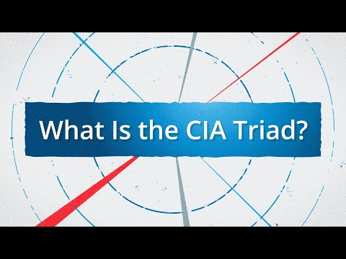
C I A TRIAD
Confidentiality
Integrity
Availability

Slide 13
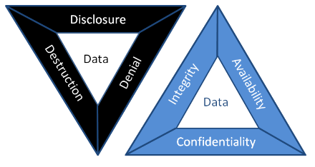
Disclosure, alteration, and destruction
Disclosure
Alteration
Destruction

Slide 14
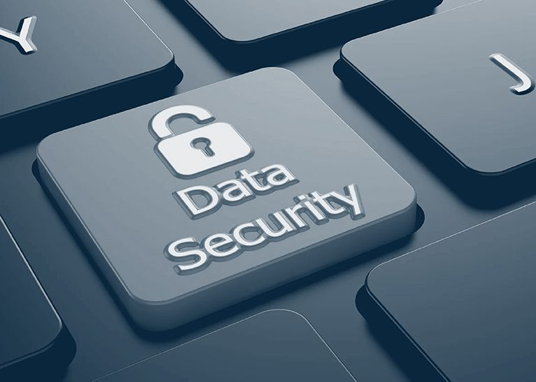
Protecting your data
Encrypt your data – TrueCrypt
Backup your data
Anti-malware protection is a must
Make your old computers' hard drives unreadable
Install operating system updates

Slide 15
Data Security in the "Cloud"
What is cloud computing?
Separation of systems
Trust in a cloud environment.
Perimeter Security
Trusted Third Party

Slide 16
Cloud Data security …........
Public Key Infrastructure (PKI).
PKI implementation models:
Strong Authentication
Strong Authorization
Data Confidentiality
Data Integrity and Non-Repudiation.

Slide 17
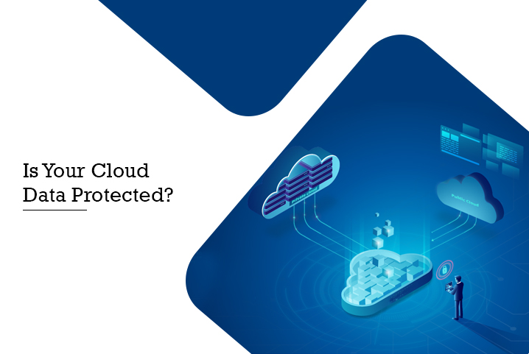
Protecting your data on a cloud system
Use a Cloud Service That Encrypts
01
Set Up Your Privacy Settings
02
Use Strong Passwords
03
Use Two-Factor Authentication
04
Use a Strong Anti-Malware Program
05

Slide 18
System security
What is System Security?
What are the vulnerability?
Malicious programs.

Slide 19
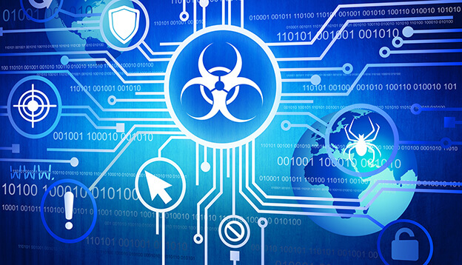
Vulnerabilities to Security systems
Unpatched Security Vulnerabilities
Hidden Backdoor Programs
Superuser or Admin Account Privileges
Security Bugs in Software or Programming Interfaces

Slide 20
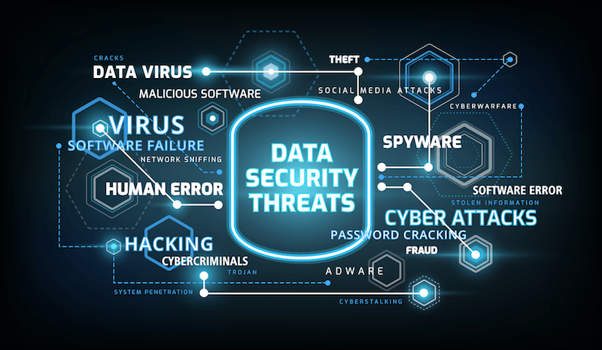
Malicious programs
Malware
Phishing
Man-in-the-middle attack
Denial-of-service attack
SQL injection
Zero-day exploit

Slide 21
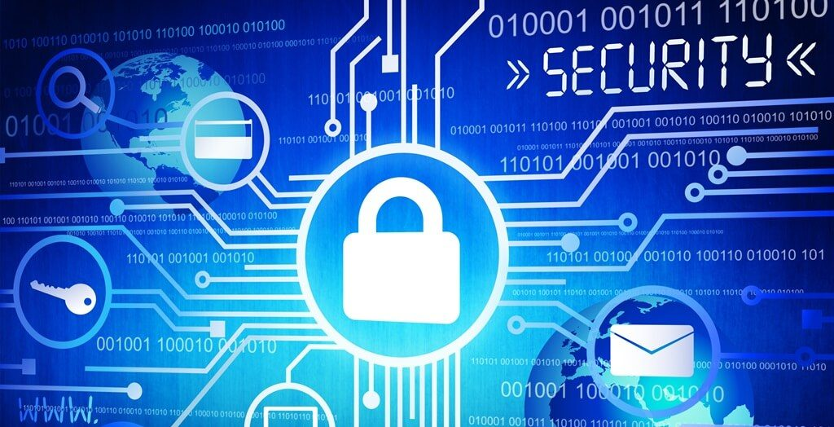
System security....... best practices
Change Management Procedures
System logs for audit trails
Data classification
Patch management strategy

Slide 22
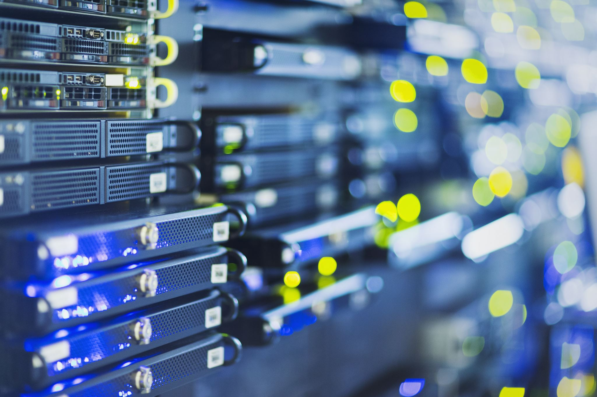
Network security Outline
Define Network Security
Exploring Network Security
What are types of Network Security?
How is it connected to Computer Security?
How is Network Security connected to Cyberethics?
How does Network Security Work?
What is the future of Network Security?
Notes:
Use this to go over Network Security Slides

Slide 23
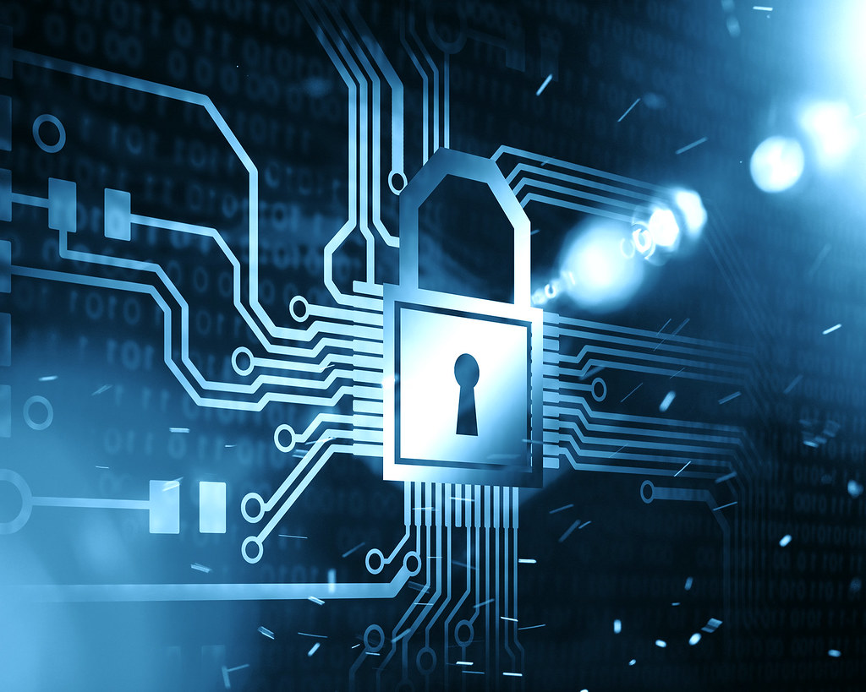
Defining network security
Is the protection of underlying network infrastructure from unauthorized access, theft, or misuse.
Works by combining multiple layers of defenses inside and at the edges of network
Notes:
What does network security do?
Secures infrastructure of privately owned networks
Secures infrastructure of the internet.
Combination of hardware and software

Slide 24
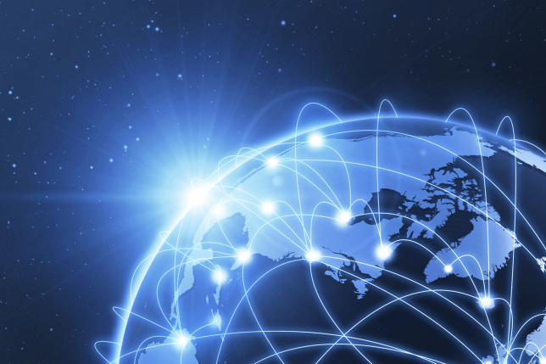
Exploring network security
Network Security is relevant to both businesses and consumers
There are many tools and applications that can help both consumers and businesses of all sizes.
Notes:
You can secure your computer and network by locking down your router, don't broadcast SSID (marginally helpful)
Use windows firewall, router firewall
Businesses use primarily software Firewalls, IDS and IPS's

Slide 25
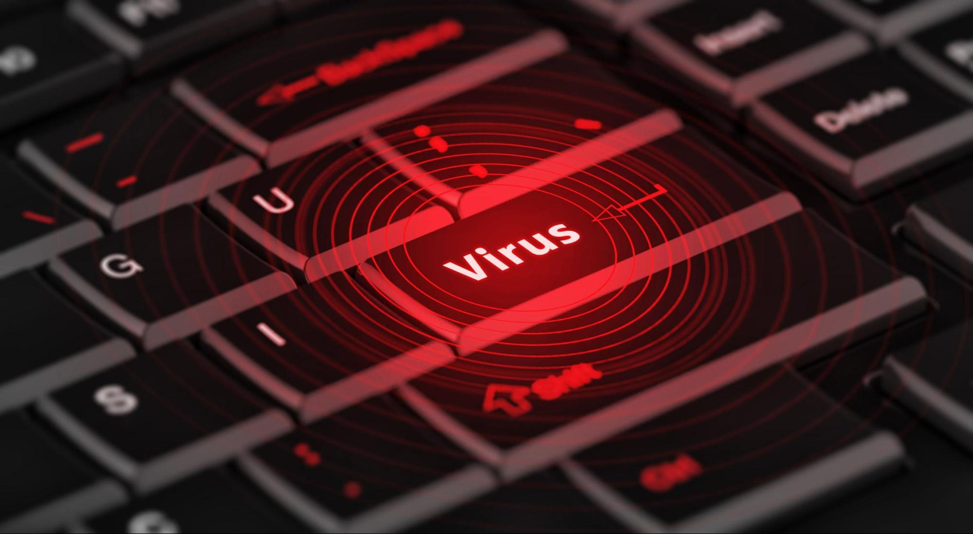
Types of network security
Network Access Control
Antivirus and Antimalware Software
Firewall Protection
Virtual Private Networks
Notes:
Network Access Control
prevent their personal devices from joining the network.
Antivirus and Antimalware Software
protect an organization from a range of malicious software, including viruses, ransomware, worms and trojans. The best software not only scans files upon entry to the network but continuously scans and tracks files.
Firewall Protection
act as a barrier between the untrusted external networks and your trusted internal network.
Virtual Private Networks
Virtual private networks (VPNs) create a connection to the network from another endpoint or site. It is as if you are working in the office connected directly to the network when you are at home.

Slide 26

How is network security connected with computer security
Network Security is third category of computer security.
Without Network Security Data Security and System security will not work.
Notes:
First category is Data Security (data in databases, SQL Databases, transmitted data)
Second category is System Security (securing hardware, and OS's, Application Software and programs)

Slide 27
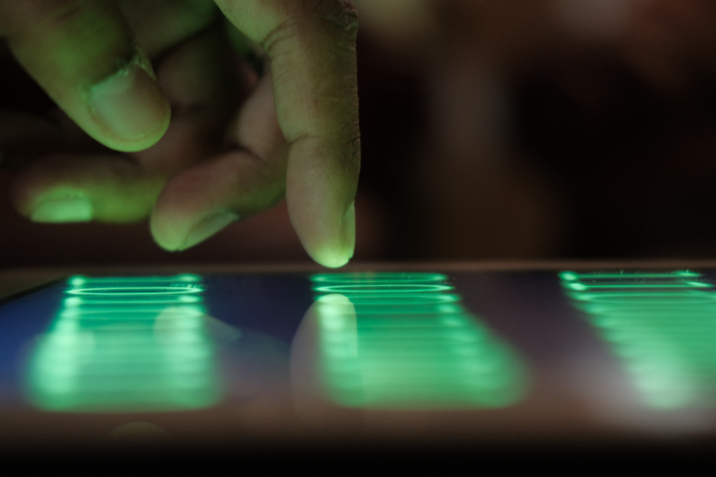
Network security and cyber ethics
Cyber Ethics aims to protect the moral, financial, and social behavior of individuals.
Cyber Ethics should engage users to use the internet safely and to use technology responsibly and in a sensible manner
Notes:
We have seen examples of hacking groups like "Anonymous" engage in cyber attacks. Are they hacktivists? Or cyberterrorists?
Hacktivism The convergence of political activism and computer hacking techniques to engage in a new form of civil disobedience
Cyberterrorism The convergence of cybertechnology and terrorism for carrying out acts of terror in (or via) cyberspace
Information warfare Using malware in cyberattacks designed to mislead the enemy and disrupt/damage an opponent’s military defense system and its critical infrastructure

Slide 28
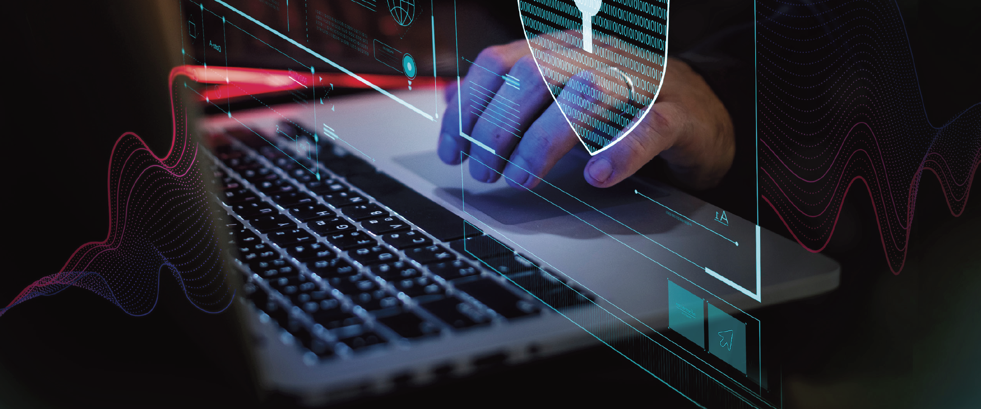
How Network security works
Physical Network Security
Technical Network Security
Administrative Network Security
Notes:
Physical Network Security
Physical security controls are designed to prevent unauthorized personnel from gaining physical access to network components such as routers, cabling cupboards and so on. Controlled access, such as locks, biometric authentication and other devices, is essential in any organization.
Technical Network Security
Technical security controls protect data that is stored on the network or which is in transit across, into or out of the network. Protection is twofold; it needs to protect data and systems from unauthorized personnel, and it also needs to protect against malicious activities from employees.
Administrative Network Security
Administrative security controls consist of security policies and processes that control user behavior, including how users are authenticated, their level of access and also how IT staff members implement changes to the infrastructure.

Slide 29

Future of network security
Implementing technology like Artificial Intelligence, machine learning, deep learning and automation
Network Infrastructure will be in the Cloud
Notes:
Artificial Intelligence can be used to detect and even prevent cyber attacks.
End of my presentation

Slide 30
references
Tavani, Herman T.. Ethics and Technology: Controversies, Questions, and Strategies for Ethical Computing, 5th Edition (p. 170). Wiley. Kindle Edition.

Slide 31
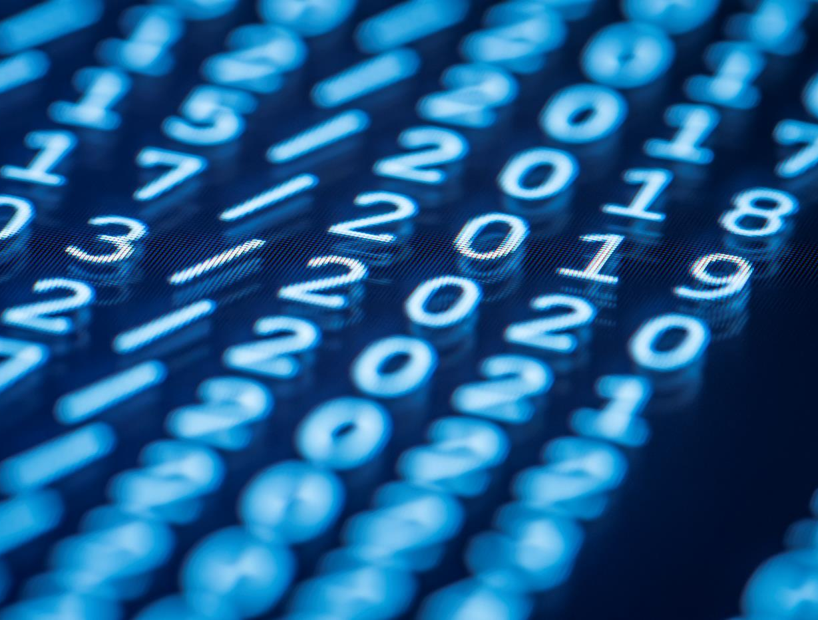
Thank You
Annie chen
Nawal kassim
Mitchell debra
Omar hernandez

